Slide 1


VISVESVARAYA TECHNOLOGICAL UNIVERSITY
BELAGAVI, KARNATAKA – 590018
Mini-Project
Introductory Presentation on
“Smart blind stick using arduino ”
by:
Bhaskar M R 1SK19EC005
Dontul Chandraprasad 1SK19EC011
Harshavardhana M L 1SK19EC014
Shreeram P 1SK19EC039
Department of Electronics and Communication Engineering
Government Sri Krishnarajendra Silver Jubilee Technological Institute
K. R. Circle, Bangalore - 560001

Slide 2
PRESENTATION OVERVIEW
Introduction
Literature Review
Object and Problem Formulation
Block Diagram
Methodology
References

Slide 3
Introduction
This walking stick is an alternative to the traditional walking stick. Here, Arduino UNO , ultrasonic sensor, IR sensor , voice playback module and voltage regulator are used. Arduino is a microcontroller which can do all the calculations very quickly with great accuracy.
The voice playback module will assist the blind person to reach the destination through the command or microphone.

Slide 4
OBJECTIVES
This stick detects the object in front of the blind person and give response to the user either by vibrating or through command. So, the person can walk without any fear.

Slide 5
* If any object is present, the ultrasonic sensor detects the object by measuring the distance between the object and the user and sends the data to the arduino UNO. *The arduino then calculates how far the obstacle is and decides which kind of warning is to be given to the blind user. *Further a voice playback system is used to give the user a audio warning. A vibrator is also used to physically warn in case of high risk.
Methodology

Slide 6
BLOCK DIAGRAM
Ultrasonic sensor
Arduino board
Bluetooth
Mobile
Buzzer

Slide 7
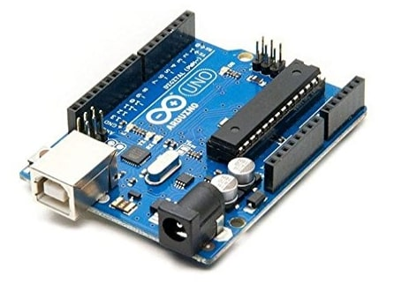
ARDUINO UNO
Arduino is an open-source electronics board and the software used to program.
Ground Pin – There are a few ground pins on the Arduino and they all work the same.
Digital Input/Output – Pins 0-13 can be used for digital input or output.
USB Connection – Used for powering up your Arduino and uploading sketches.
TX/RX – Transmit and receive data indication LEDs.
Power LED Indicator – This LED lights up anytime the board is plugged in a power.
Voltage Regulator – This controls the amount of voltage going into the Arduino board.
3.3V Pin – This pin supplies 3.3 volts of power.
5V Pin – This pin supplies 5 volts of power.
Analog Pins – These pins read the signal from an analog sensor and convert it to digital.

Slide 8
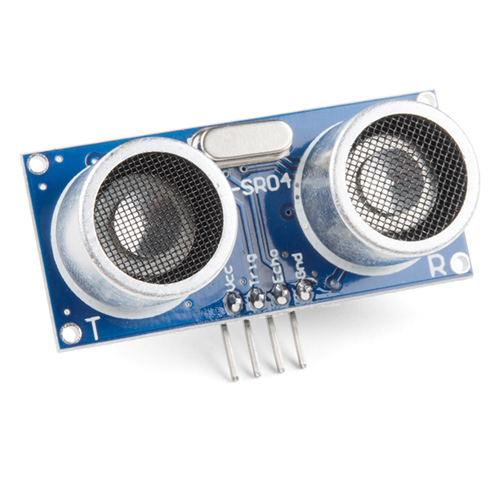
Ultrasonic sensor
An ultrasonic sensor is an instrument that measures the distance to an object using ultrasonic sound waves.
Distance = (Time * Speed of Sound)/2
ULTRASONIC SENSOR | ARDUINO
VCC | 5V
Trig | Pin 11
Echo | Pin 12
GND | GND

Slide 9
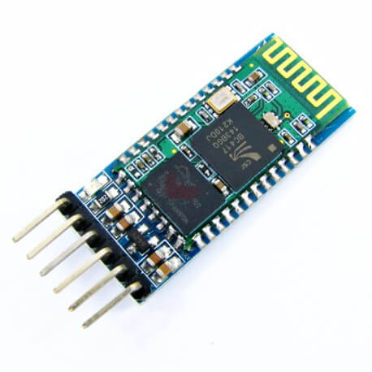
Bluetooth
Bluetooth device used for wireless communication with Bluetooth enabled devices.
Pin Name | Description
VCC | Powers the module
GND | Ground pin of module
TX | Transmits Serial Data
RX | Receive Serial Data

Slide 10
Smartphone

Slide 11
Literature Review
Paper | Summary | Hardware/Software Used
I | Smart Stick Using Arduino Uno: Aiding The Visually Impaired Project by Dhruvin Patel, Harshit Patel, Hiren Patel & Nirav Patel . | Arduino,ultrasonic sensor,buzzer
II | Arduino-based smart blind stick by Venugopal M | Arduino Pro Mini, HR-SR04 Ultrasonic Sensor, RF Transmitter
III | Blind Walking Stick Using Arduino & Ultrasonic Sensor HC-SR04 | Arduino UNO Board, HC-SR04 Ultrasonic Sensor, Buzzer and Switch

Slide 12
REFERENCES
G. Prasanthi and P. Tejaswidho Sensor assisted Stick for the Blind People-Transmission on Engineering and Sciences, vol:3,number 1, pp-, 12-16,2015
https://create.arduino.cc/projecthub/mohammadsohail0008/smart-stick-for-blind-peoples-5ee884
Smart Cane Assisted Mobility for the Visually Impaired, World Academy of Science, Engineering and technology International Journal and Information Engineering Vol:6 No:10,2012
.
W. Docbelle Artificial Vision for the blind by Connecting a Television Camera to the Brain, ASAIO Journal, Vol:46, page 3-9,2010.

